Slide 1
Lab 1: Scaling Web Servers
Concurrent vs. Parallel Request Serving in Python

Slide 2
Introduction to Scalability
In today's digital world, services need to handle many requests at once. Think websites, apps, APIs – all serving numerous users simultaneously.
Scalability is the ability of a system to handle increasing amounts of work, or to be easily expanded to accommodate growth. In our context, it's about serving more requests without slowing down.

Slide 3
Introduction to Scalability
This lab explores two fundamental approaches to building scalable systems
Concurrency
Parallelism
We'll use Python to implement and compare different server models, understanding their strengths and weaknesses in handling client requests.

Slide 4
Request Serving Problem

Slide 5
Request Serving Problem - Introduction
What is the "Request Serving Problem"?
Multiple clients (users, browsers, apps) send multiple requests each to the server.
The server's job is to process these requests and send back responses to the corresponding client.
Challenge: How to scale this to millions of clients/requests?

Slide 6
The Request Serving Problem - Introduction
I/O-Bound Scenarios:
Many server tasks are I/O-bound, like reading from a database, waiting for network data, accessing files.
Examples:
App Servers: Waiting for data from databases, file systems, or external APIs.
API Gateways: Forwarding requests, waiting for responses from BE services.
Chat Servers: Waiting for messages to be sent and received over the network.

Slide 7
Single Threaded Server

Slide 8
Single Threaded Server - Concept
A single-threaded server can only serve one client at a time.
It processes requests sequentially
Basic Implementation (Conceptual):
Listens for an incoming connection
Accepts the connection
Handle the request
Waits for request completion
Send response back
Repeat

Slide 9
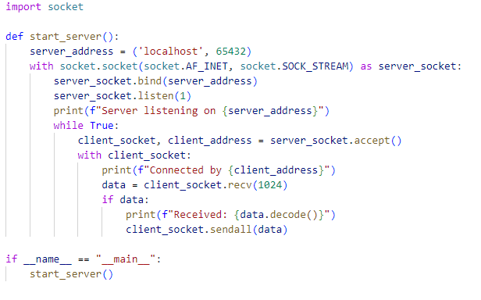
Single Threaded Server - Implementation
A single-threaded server can only serve one client at a time.
It processes requests sequentially
Basic Implementation (Conceptual):
Listens for an incoming connection
Accepts the connection
Handle the request
Waits for request completion
Send response back
Repeat

Slide 10
Single Threaded Server - Limitations
Poor Performance under Load: The server is blocked while handling the request which becomes a bottleneck especially in IO tasks.
Not Scalable: Cannot handle concurrent users.

Slide 11
Concurrency & Parallelism
Credits: bytebytego.com

Slide 12
Concurrent vs. Parallel Serving - Concurrency
Concurrency manages multiple tasks at the same time within a single thread or process. It gives the illusion of tasks running simultaneously.
Key Idea
Time Slicing/Context Switching: The single thread rapidly switches between tasks, giving each a little bit of time. If one task is waiting (e.g., for I/O), the thread can switch to another task that's ready to run.

Slide 13
Concurrent vs. Parallel Serving - Parallelism
Actually executing multiple tasks simultaneously by using multiple cores or processors.
True Simultaneous Execution: Tasks are truly running at the exact same time on different processing units.
Requires Multiple Cores: Parallelism needs hardware support – multiple CPU cores.

Slide 14
Choosing the Right Approach
Concurrency (for I/O-bound tasks)
Best for: Tasks that involve a lot of waiting (I/O).
Why it works: While one task is waiting for I/O, the thread can switch to another task that's ready to proceed. This maximizes the utilization of a single CPU core.
Python asyncio library can be used to achieve concurrency.
Parallelism (for CPU-bound tasks)
Best for: Tasks that require heavy computation and utilize the CPU intensely.
Why it works: Distributing the computational load across cores significantly speeds up processing.
Python's multiprocessing library enables true parallelism.

Slide 15
The Python Global Interpreter Lock (GIL)
Allows only one thread to execute Python bytecode at a time within a single process.
Limits true parallelism in threads for CPU-bound tasks in standard Python (CPython).
The GIL is often released when a thread is waiting for I/O, allowing concurrency.
GIL and Multiprocessing: Processes in Python have their own interpreters and memory spaces, and therefore bypass the GIL. multiprocessing provides true parallelism.

Slide 16
Synchronous Server - Threaded Server Concept
The server creates a new thread per incoming connection.
Threads can run in parallel (time-sliced) within the same process, managed by the operating system.

Slide 17
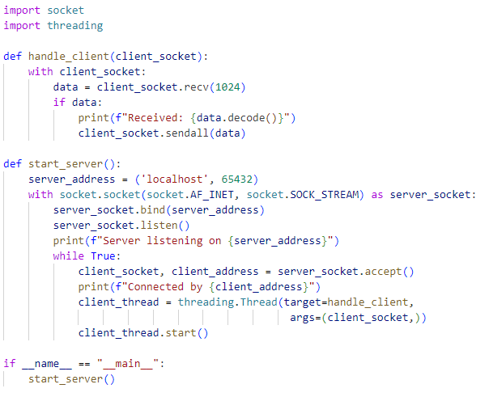
Multi Threaded Server - Implementation
Basic Implementation (Conceptual):
Server listens for connections.
On new connection, create a new thread.
Thread handles the request synchronously (blocks until done).

Slide 18
Multi Threaded Server - Vulnerability
Denial-of-Service (DoS) Attack: An attack that aims to overwhelm a server, making it unavailable to legitimate users.
What happens? The server keeps creating new threads for each request.
Problem: Thread creation has overhead. Creating too many threads quickly exhausts server resources (memory, CPU context switching), leading to slowdowns and crashes.

Slide 19
Multi Threaded Server - Resource management
Thread Pool Concept
Instead of creating a new thread for each request, use a pool of pre-created threads.
Requests are submitted to the pool, and a thread from the pool is assigned to handle it.
Resource Management: Limits the number of threads, preventing uncontrolled thread creation and resource exhaustion.

Slide 20
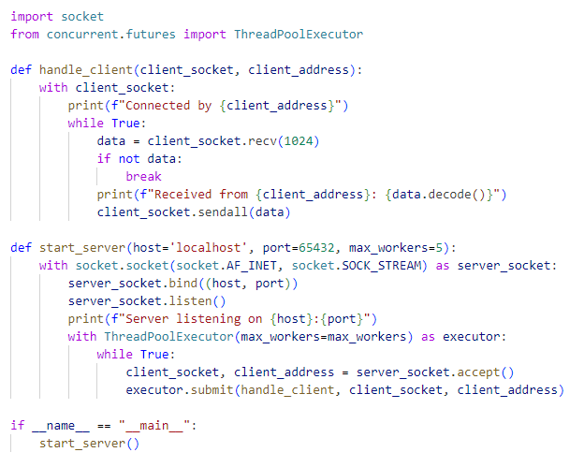
Multi Threaded Server - Thread pools
Basic Implementation (Conceptual)
Create a fixed-size thread pool
Accept Connection
Submit request to the threadpool
After the request is handled, the thread returns to the pool.

Slide 21
Multi Threaded Server - Thread pools trade-off
Benefits of Thread Pools
Resource Management: Controls thread creation, prevents DoS from thread exhaustion.
Reduced Overhead: Reusing threads is more efficient than creating new ones for each request.
Improved Responsiveness: Server is more responsive under moderate load.
Limitations
Thread-Based: Context switching overhead can become a bottleneck under very high load.
Limited Parallelism: GIL still limits true parallelism for CPU-bound tasks within the pool.
Limited Scalability: Thread pools have a fixed size, so they can still be overwhelmed if the request rate is extremely high.

Slide 22
Process Pool Server - True Parallelism
Use a pool of processes instead of threads.
Each process has its own Python interpreter and memory space, bypassing the GIL.
Enables true parallelism for CPU-bound tasks by utilizing multiple CPU cores fully.
Implementation (Conceptual)
Similar to thread pool, but creates a pool of processes.
Suitable for CPU-intensive request handling.

Slide 23
Process Pool Server - True Parallelism
When to Consider Process Pools
If your server tasks are CPU-bound (e.g., heavy computations, data processing).
Need to fully utilize multi-core CPUs for performance.
Trade-offs
Higher Overhead: Process creation is generally more resource-intensive than thread creation.
Inter-Process Communication (IPC): Sharing data between processes is more complex than between threads in the same process.
Not ideal for I/O-bound tasks: Overhead of processes might outweigh the benefits for tasks that are primarily waiting for I/O.

Slide 24
Asynchronous Server

Slide 25
Asynchronous Server - Event Loops
Uses a single thread and an event loop to handle multiple requests concurrently.
Non-Blocking I/O: Instead of blocking and waiting for I/O operations to complete, the server initiates the I/O and then moves on to handle other tasks.
Event Loop: Monitors for I/O events (data ready to be read, socket ready to write, timers expiring). When an event occurs, the event loop dispatches the appropriate task to handle it.
async and await keywords enable writing asynchronous code.
async defines a coroutine (a function that can be paused and resumed)
await pauses execution until an I/O operation completes, without blocking the entire thread.
Cooperative Multitasking: Tasks voluntarily yield control back to the event loop when they are waiting for I/O, allowing other tasks to run.

Slide 26
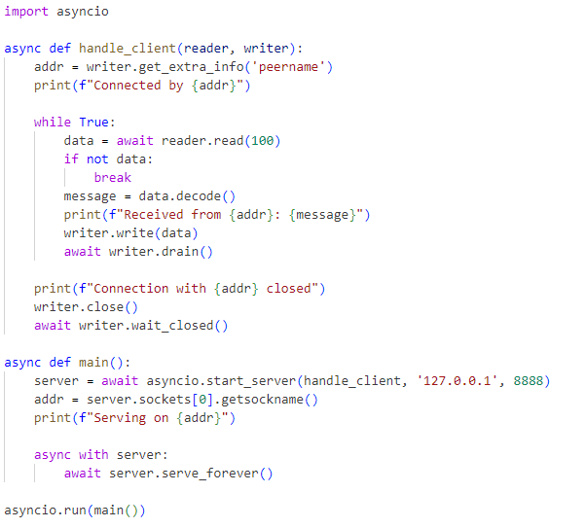
Asynchronous Server - Implementation
Basic Implementation (Conceptual)
Server starts an event loop
Defines asynchronous request handlers
When a request comes in, an asynchronous handler is scheduled to run in the event loop
When the handler encounters an await, it yields control to the event loop and is put on a waiting queue
The event loop picks up a ready task
When the I/O operation completes, the event loop resumes the paused handler

Slide 27
Asynchronous Server - How Concurrency is Achieved?
Cooperative Multitasking: Tasks cooperate by yielding control, allowing efficient use of a single thread.
Event Loop Efficiency: The event loop is highly efficient at managing and dispatching tasks based on I/O events.
Non-Blocking I/O: The key is non-blocking I/O operations. Asynchronous libraries use non-blocking system calls, so the thread doesn't get stuck waiting.
No Thread Overhead: Avoids the overhead of thread creation and context switching.

Slide 28
Demo

Slide 29
Demo Setup - Server
A web server listens on TCP sockets to handle either CPU-bound or I/O-bound tasks.
Five variants of this server are available
Single Threaded Server
Multi Threaded Server
Multi Threaded Server - With thread pools
Asynchronous Server - Using I/O Multiplexing
Asynchronous Server - Using Asyncio library

Slide 30

Demo Setup - Client
Apache JMeter allows users to simulate multiple users accessing a service simultaneously, enabling the assessment of performance under different load conditions.
Credits: apache.org

Slide 31
Demo Results - CPU Bound Task
Concurrent Users | Server | Throughput (req / s) | Min. Response Time (ms) | Max. Response Time (ms) | Avg. Response Time (ms)
1 | Threadpool | 13.7 | 31 | 31 | 31
 | Asyncio | 14.3 | 28 | 28 | 28
10 | Threadpool | 32.3 | 80 | 266 | 189
 | Asyncio | 32.3 | 110 | 266 | 190
100 | Threadpool | 36.8 | 385 | 2636 | 1467
 | Asyncio | 38.1 | 97 | 2568 | 1754
1000 | Threadpool | 38.6 | 394 | 25583 | 12935
 | Asyncio | 29.5 | 56 | 33799 | 14509

Slide 32
Demo Results - I/O Bound Task
Concurrent Users | Server | Throughput (req / s) | Min. Response Time (ms) | Max. Response Time (ms) | Avg. Response Time (ms)
1 | Threadpool | 0.1 | 15031 | 15031 | 15031
 | Asyncio | 0.1 | 15030 | 15030 | 15030
10 | Threadpool | 0.7 | 15043 | 15119 | 15043
 | Asyncio | 0.7 | 15036 | 15079 | 15042
100 | Threadpool | 6.5 | 15156 | 15383 | 15278
 | Asyncio | 6.5 | 149* | 15282 | 12524*
1000 | Threadpool | 51.9 | 15127 | 18679 | 16680
 | Asyncio | 52.8 | 460* | 18780 | 8891*

Slide 33
Real-World Servers

Slide 34
Real-World Servers - Apache HTTP Server (via XAMPP)
Widely Used Web Server: One of the most popular web servers historically.
Architecture:
MPMs (Multi-Processing Modules): Apache uses MPMs to handle concurrency.
Prefork MPM: Creates multiple processes at startup. Each process handles one request at a time (process-based concurrency) → Older, less efficient for high concurrency.
Worker MPM: Uses multiple threads within each process. More efficient than pre-fork, but still thread-based within processes.
XAMPP: A free, easy-to-install package (Apache, MySQL, PHP) – great for experimenting with Apache locally.

Slide 35
Real-World Servers - Tomcat
Java Servlet Container: Primarily used to run Java web applications (Servlets, JSPs).
Threading Model: Tomcat is multi-threaded. It uses a thread pool to handle incoming requests.
Java's Threading: Java's threading model is different from Python's and is not affected by the GIL in the same way.
Java threads can achieve true parallelism on multi-core systems for both CPU-bound and I/O-bound tasks.

Slide 36
Real-World Servers - NGINX
Modern Web Server & Reverse Proxy: Known for its high performance and efficiency, especially in handling large numbers of concurrent connections.
Event-Driven Architecture: NGINX is built on an event-driven, asynchronous, non-blocking architecture, similar in concept to asyncio.
Highly Scalable: Designed to handle massive concurrency with minimal resource usage.
Reverse Proxy & Load Balancer: Often used as a reverse proxy in front of application servers (like Apache or Tomcat) to handle incoming client connections, load balancing, and static content serving.

Slide 37
Conclusion - Key Takeaways
Single-threaded servers are not scalable for handling concurrent requests.
Threaded servers offer concurrency but are vulnerable to DoS and have overhead.
Thread pools improve resource management in threaded servers.
Process pools enable true parallelism but have higher overhead.
Asynchronous servers (like asyncio) provide highly efficient concurrency for I/O-bound tasks using a single thread and an event loop.
Industry servers like NGINX utilize event-driven architectures for massive scalability.

Slide 38
Conclusion - Choosing the Right Approach
I/O-bound tasks: Asynchronous servers are often the best choice.
CPU-bound tasks: Process pools are necessary for true parallelism.
Hybrid scenarios: Real-world systems often combine different approaches. For example, using NGINX as a front-end reverse proxy to handle connections and load balance requests to backend application servers (which might be threaded or asynchronous).

Slide 39
References
Concurrency vs Parallelism: The Main Differences
Concurrency Vs Parallelism! - ByteByteGo
Blocking Single Threaded Web Server
How async/await works in Python?
Async IO in Python: A Complete Walkthrough
Apache HTTP Server — Multi-process architecture
When is NodeJS Single-Threaded and when is it Multi-Threaded?
Nginx: The Swiss Army Knife of Web Servers
JMeter Performance Testing

